Slide 1
Cognizant Hi Tech Competitor Intelligence Report
Research & Analysis Desk, Corporate Marketing & High Tech Marketing
CONFIDENTIAL
October 9, 2013
TCS Confidential

Slide 2
Table of Contents
Executive Summary
Cognizant Hi Tech Evolution
Financials Revenue Distribution
Hi-Tech Contract and deals
Key Offerings in Hi Tech
Global Delivery Network
Technology Competency
Hi Tech Focus & Capabilities
Hi Tech Practice - Strategic Differentiators
SMAC & Cloud services
SWOT Analysis for Cognizant
Executives Speak
Key Acquisitions
Strategic Alliances and Technology partners
Analyst Comments and Rank in industry
Key Investments
Recent Milestones
Key Executives

Slide 3
Executive Summary
Financial Performance
The vertical including communications, information/media/entertainment and high technology, grew 12% over 2011.
Other industries (revenue reporting segment) is 877.5 Million for 2012. The approximate High Technology revenue to 30 to 35 % of other industries which comes to around $ 300 Million.
High Tech Focus
Cognizant serve some of the world’s leading independent software vendors, or ISVs, technology equipment manufacturers, and online service providers. They assist the ISVs with their transitions to new business models (such as Software-as-a-Service, or SaaS models) and facilitate their license management and sales processes.
Cognizant's strong capabilities in controls and automation, product lifecycle management and embedded systems are helping clients improve efficiencies, reduce time-to-market and provide better customer service.
Cognizant continues its investment in technology platforms like Cognizant 2.0 , SMAC , Cloud which are increasingly become a key differentiator than its competitors. It has strong SAP implementation skills in manufacturing making it a strong choice among customers.
Other in-demand services include CRM, Product Technical Support, Supply Chain Management and the application of SMAC technologies to the customer experience, as well as Application Development, Systems Integration and Application Maintenance.
Collaboration
Cognizant partnering with six of the world’s top 10 software vendors like 1) Microsoft 2) SAP AG 3) Adobe 4)IBM 5)Oracle and others.
Cognizant key clients in High Tech segments are: {A} Software segment – 1) Microsoft 2) SAP AG 3) Adobe {B} Semiconductor – 1) Applied Materials 2) Infineon {C} Computer Platform and Storage – 1) Agilent Technologies 2) NetApp {D} Electronics - 1) Royal Philips Electronic
Analyst comments and Recognition
Recognized as a Leader in North American workplace services outsourcing by Forrester
Recognized as a Leader in Capital Markets BPO by Everest Group
Positioned in the "Leaders" Quadrant of Gartner’s 2012 Magic Quadrant for CRM Service Providers Worldwide

Slide 4
Cognizant High Tech evolution
Deutsche Telekom's enterprise customer division, T-Systems, and CTS entered into global systems integration alliance to provide European corporations with global delivery requirements for system integration services.
Officially opened a delivery center in Buenos Aires, Argentina.
CTS formally launched its delivery center in Budapest, Hungary to provide near-shore IT and BPO services.
CTS also launched 'Touchstone Center' at its facility in Bangalore
In May 2009, the company formed a global services partnership with SAP to deliver increased business value by expanding collaborative relationship and global footprint.
Signed an initial five-year, multi-million dollar contract with Invensys.
Announced operational expansion of Phoenix delivery center, adding BPO services to an existing roster of application ADM, testing and related services.
CTS acquired two companies including London –based global program management consulting firm PIPC in May 2010 and Paris-based Galileo Performance, IT, testing consultancy.
Dow Jones reported that Cognizant Technology Solutions Corp., and Cap Gemini SA are in talks with Oracle Corporation to buy the services business of its India unit, Oracle Financial Services Software Limited
Cognizant Technology Solutions Corp To Acquire Six Companies Of C1 Group.
Cognizant Technology Solutions Corp. and CoreLogic,Inc announced a definitive agreement under which Cognizant will acquire CoreLogic,Global Services Private Limited (CoreLogic India).
On July 2012, CTS Providing consulting and IT application services in order to help Philips Electronics to increase efficiency of its IT resources.
In Jan 2013, Synergy Systems make alliance with Cognizant based on SaaS platform too help retailers increase sales, improve customer satisfaction, and optimize employee productivity, by increasing the level of transparency and accountability between retailers and vendors servicing the stores .
2008
2009-10
2011-12
2013

Slide 5
Financial Revenue Distribution
Revenue Distribution Across Verticals
OPERATING GROUPS | Fiscal (in millions of U.S. Dollars) |  | % of Total Net Revenues for Fiscal
 | 2012 | 2011 | 2012
Financial Services | 3.035 | 2.518 | 20.53
Healthcare | 1.934 | 1.622 | 19.23
Manufacturing | 1.498 | 1.197 | 25.14
Others | .877(11.93%)* | .783(12.79%)* | 12
Total | 7.346 | 6.121 | 20.01
* Of total revenue
Operating Margin Across Verticals
OPERATING GROUPS | Fiscal (in millions of U.S. Dollars) |  | % of Total Operating margin for Fiscal
 | 2012 | 2011 | 2012
Financial Services | .998 | .872 | 14.45
Healthcare | .724 | .625 | 15.84
Manufacturing | .527 | .440 | 19.77
Others | .288(21.16%)* | .254(22.36%)* | 13.38
Total | 1.361 | 1.136 | 19.80
* Of total operating margin

Slide 6
Cognizant HiTech CI: Contracts (IDC)
Customer Name | Industry | Sub-Industry | Geography Scope | Deal Description | Deal Value | Signing Date
Orkla A.S.A | Process Manufacturing | Consumer Products (Process) | Global | IT infrastructure, applications and support services from OSS | 189,881,056 | 15-May-13
INTTRA, Inc. | Professional Services | Computer Programming and Data Processing Services | Global | A range of application development, application maintenance, testing, and quality assurance services using the managed services model | 4,500,000 | 2-Jan-12
AstraZeneca plc | Process Manufacturing | Bio/Pharma | Global | Centralized statistical programming; statistical analysis, medical writing, document publishing services | 50,000,000 | 23-Nov-11
IHS Inc. | Professional Services | Computer Programming and Data Processing Services | Americas | To grow through acquisitions by rationalizing disparate systems and consolidating financial business processes through the enterprise SAP Financial roll-out, and by providing a standardized solution across all acquired companies and business entities to ensure consistency | 5,500,000 | 10-Feb-11
CoreLogic, Inc. | Professional Services | Computer Programming and Data Processing Services | Americas | CpreLogic intends to use the cash proceeds towards its expansion into new growth markets, and believes that Cognizant has the solid, proven track record that makes it an excellent choice to support this strategy. | 324,000,000 | 10-Aug-11
Feihe International, Inc. | Process Manufacturing | Consumer Products (Process) | Asia Pacific | Feihe International to trace foods, feeds, ingredients, and food-producing animals through all stages of production, processing, and distribution. | 550,000 | 5-Jul-11
Pistoia Alliance, Inc. | Professional Services | Business Management Services | EMEA | Cognizant and Eagle Genomics will develop a conceptual platform, aims to define and document an externally hosted service for securely storing and mining the proprietary derived gene/sequence information and public domain gene databases. | 700,182 | 1-Apr-11
Volvo Car Corporation (VCC) | Discrete Manufacturing | Automotive | Global | Cognizant will operate and optimize Volvo Car Corporation's F&A processes, while improving cost effectiveness and service delivery. | 100,000,000 | 15-Mar-11
Eli Lilly and Company | Process Manufacturing | Bio/Pharma | Americas | Cognizant will deliver solutions spanning: commercial analytics, sales force planning; customer relationship management (CRM);data warehousing; - state compliance reporting using a consumption-based service delivery model called Business Process as a Service (BPaaS). | 100,000,000 | 10-Jan-11
Notes:
Buyer Pulse Services Deals Excel Export…IDC Contracts

Slide 7
Cognizant HiTech CI: Offerings
Online Companies
For the online companies content demands, application features, and user experience requirements are exploding as delivery channels multiply.
At the same time, social media, online trust and safety, and dynamic competition are making customer relationship management increasingly complex.
Need
CTS Offering
Five of the world's top seven online companies are Cognizant customers. Such experience provides CTS the skills and insights to help with virtually any technology project, whether it involves rapid product development, managing rich media, adopting social marketing processes, creating mobile platforms, driving user adoption, cultivating customer loyalty, or protecting consumer privacy.
Product Engineering
Cognizant can provide online technology company or e-commerce operation with almost any task across the product engineering lifecycle, including:
Product Conceptualization and Ideation, Experimental Learning, High-Fidelity Prototyping, Test-Driven Development
Scrum Iterative Development, Social Media Integration , Full-Spectrum Product Testing, User Experience Research and Design, Usability Testing, Mobility, Business Intelligence and Data-Driven User Insights.
CTS Solution
Business Optimization
Business optimization capabilities for online technology companies and e-commerce retailers span the enterprise, including:
Supply Chain Coordination, Enterprise Resource Planning, Business Analytics, Enterprise Information Management
Fulfillment Processing, Finance Transformation, Online Trust and Safety, Cloud Migration, Advertising Management
Customer Support, Infrastructure Development
Client
Inttra is a client of ecommerce service of Cognizant.
Notes:
http://www.cognizant.com/technology/business-optimization-onlinecompanies

Slide 8
Cognizant HiTech CI: Offerings
Online Companies
Case Study: Company name not published
Problem
The client sought a technology partner that could scale up the architecture quickly without sacrificing the nimbleness of the site and the quality experiences its customers were accustomed to. Put another way, it wanted to optimize the online experience so customers could quickly and easily find and buy products, and keep coming back.
The client’s original platform was written in C++, a long-popular object-oriented programming language developed in the early 1980s. However, the code base wasn’t very scalable, which challenged the client to achieve its business goals. In 2002, the goal was to move the C++ code to a Java-based platform, which required technical skills and infrastructure support that the client lacked, as well as using pooling strategies that gradually phased out the old code while the new code entered production.
CTS solution was to deploy a globally distributed team based in several locations across three continents – North America (San Jose and Salt Lake City), Europe (London) and Asia (Shanghai, and the Indian cities of Bangalore, Chennai, and Pune) – and an Agile software development methodology called “distributed Scrum,” .
Distributed Scrum, meanwhile, helps in the execution of projects with very tight development windows, taking advantage of as much of the world’s 24-hour daily spectrum as possible given the global makeup of our project team.
From 2002 to 2004, the team completed more than 25 reengineering projects across various site domains, such as item and catalog management, the main e-commerce site, subscriptions and the payment gateway. As specified, CTS also converted the C++-based platform to a command based Java architecture, which allowed for better scalability.
Partnership with Cognizant
By the time CTS finished in the summer of 2004, the new architecture served as a foundation that enabled the client to grow its revenues 135% from 2004 to 2007, while profits grew 122%.
This project enabled the client to bring new functionality to market faster and scale up its architecture quickly, with a projected annual savings of $50 million to $100 million that could be reallocated to strengthen its business core.
Because the company is an e-commerce leader, it depends on IT to extend its market dominance. (Nearing the end of 2011, revenues since the end of 2007 had grown more than 40%.)
Solution
Notes:
http://www.cognizant.com/InsightsCasestudies/E-commerce-Leader-Modernizes-IT-Architecture-Gains-Scale-and-Agility.pdf

Slide 9
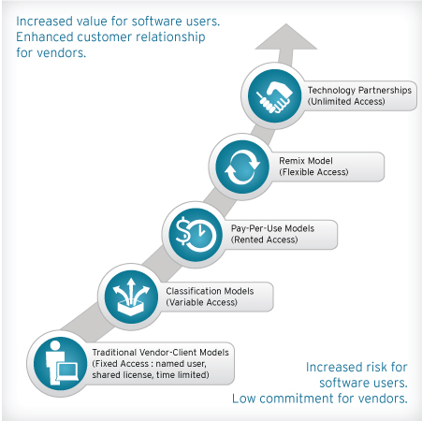
Cognizant HiTech CI: Offerings
Software Services
Software vendors face a new era driven by cloud computing and virtualization. Now Software-as-a-Service (SaaS) is rapidly becoming the dominant way software is bought and sold.
Cognizant, serving six of the world's top 10 software vendors, provides organization adapt to this new competitive and technological reality.
Cognizant Solution
Product Engineering
SaaS Product Development, Product Conceptualization, Agile and Scrum Iterative Development, Application Testing, User Experience Design, Software Lifecycle Management.
Business Optimization
SaaS Business Support, License Management, Supply Chain Coordination, Enterprise Resource Planning, Business Analytics, Data Warehousing, Digital Security and Privacy, Fulfillment Processing, Finance Transformation.
Cognizant Offerings
Packaged applications (SCM, CRM, ERP): Product selection, design, rollout, ongoing maintenance and support.
Enterprise data warehouse and business intelligence: Strategy, master data management, performance investigation and tuning, maintenance, and support services.
Custom application development: Maintenance and support.
BPS and IT IS: White-labeling services, remote infrastructure management, voice- and transaction-based.
Notes:
http://www.cognizant.com/technology/software-vendors

Slide 10
Cognizant HiTech CI: Offerings
Cognizant HiTech CI: Offerings
Clients for Software Services
Clients for Information Management and Services
Johnson Controls Inc.
Dorado Corporation
Microsoft Corporation
Invensys Operations Management
Ask Partner Network
ADP Dealer Services Group
AMD, Inc.
Autodesk, Inc.
Automatic Data Processing, Inc.
Computer Associates
CoreComm Internet Services, Inc.
EarthLink, Inc.
Ingres Corporation
Intuit Inc.
Macrovision Solutions Corporation
NetApp, Inc
SAP Lab
SERENA Software, Inc.
SpikeSource, Inc.
TriZetto Group, Inc.
CCC Information Services Group Inc. (acquired by Investcorp)
T-Systems, Germany
Hitachi Ltd.
Arbitron Inc.
Maritz Inc.
News America Marketing
OTX Corporation
Simon & Schuster, Inc.
Telerx Marketing Inc.
The Nielsen Company
United Business Media
Dun & Bradstreet (D&B)
EDS Technologies

Slide 11
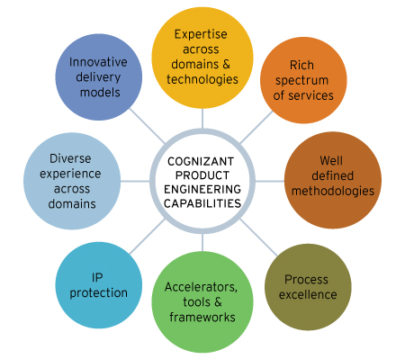
Cognizant HiTech CI: Offerings
High Technology Manufacturers
The world of high-tech manufacturing is changing rapidly. New trends such as the consumerization of information technology, the millennial workforce, cloud computing, virtualization, mobility, and social media, the Future of Work is creating new opportunities and challenges for device and equipment makers.
Need
Product Engineering
Cognizant provide high-tech manufacturers with virtually any task across the product engineering lifecycle, including:
Product Concepting, Agile and Scrum Iterative Development, Product and Software Testing, User Experience Design, Product Lifecycle Management.
CTS Solution
Business Optimization
By leveraging Cognizant Value Creation Framework, which includes proprietary planning tools and methodologies, CTS serves architect solutions for near-term cost savings and long-term business transformation. The framework—created through a rigorous two-year collaboration with leading global companies—helps Cognizant's clients chart a step-by-step roadmap to the Future of Work.
Cognizant business process optimizations capabilities for high-technology manufacturers span the enterprise, including:
Supply Chain Coordination, Enterprise Resource Planning, Business Analytics, Enterprise Information Management, Digital Security and Privacy, Fulfillment Processing, Finance and Accounting.
Notes:
http://www.cognizant.com/technology/product-engineering-manufacturers

Slide 12
Cognizant HiTech CI: Offerings
Clients for Manufacturing Services
Ford Motor Company
Akzo Nobel N.V.
TETRAPAK
3M
CNH Global N.V.
Continental Corporation Ltd (CCL)
Coors Brewing Corp
Dow Corning Corporation
eGM (the e-business arm of General Motors that was reverse-integrated into General Motors in 2002).
Harris Corporation
Invensys
Invensys Rail Group
Vauxhall Motors Limited
Volvo Car Corporation
Rexam Beverage Can North America
Continental A.G

Slide 13
Cognizant HiTech CI: Offerings
Case Study
Consumer Electronics
With expertise across the entire lifecycle – product conceptualization, product engineering and design, quality assurance certification and manufacturing and support – Cognizant’s solutions can lead to cost reductions, productivity gains and faster time-to-market.
Electronics Manufacturing Services can help with set-top box and mobile platform development, universal remotes and mobile controllers for embedded devices, smart TVs, Internet and cable TV convergence solutions, and next-generation digital convergence solutions.
Case Study: Invensys
Problem
At time when companies are faced with rapidly changing market scenario and increased competitiveness, there is an increasing need to be proactive, rather than reactive in making strategic business decisions. The need of the hour for businesses is to focus on what they’re really good at and ensure they can deliver their wares to market faster, smarter, and at lower costs. Same happens with Invensys.
Partnership with Cognizant
Invensys and Cognizant have a broad relationship encompassing R&D, joint go-to-market as well as innovation dimensions. The partnership was created on the tenet that both organizations can together achieve in the marketplace, more than what they are individually able to. In 2009, Cognizant formed a strategic global partnership with Invensys. Through this powerful partnership, Cognizant provides ongoing product development services for Invensys while at the same time Cognizant remain a strategic partner and have forged a go-to-market strategy with them.
Solution
Cognizant helped the client in developing Universal Remote that can be used as intermediate device to control the entertainment devices from Wi-Fi enabled devices such as PC, iPhone, etc.
Integration of Open source tool chains – cross compiler, debugger, Anjutha, performance tools into Open Embedded cross-compile environment to build complete Linux Distribution for embedded systems.
Setup and configure HUDSON and fitness environment for test/build automation.
Design and development of WiFi Network Manager that supports WEP/WPA/WPA2/ WPA enterprise security
Developed generic language agnostic (C/ C++/Java) IPC messaging layer for inter process/ thread communication.
Notes:
http://www.cognizant.com/InsightsCasestudies/Development%20of%20universal%20remote%20control.pdf

Slide 14
Cognizant HiTech CI: Offerings
Case Study
Consumer Electronics
Case Study: Royal Philip
Company Information
Royal Philips Electronics of the Netherlands is a diversified health and well-being company, focused on improving people’s lives through meaningful innovation in the areas of healthcare, consumer lifestyle and lighting. Headquartered in the Netherlands, Philips posted 2012 sales of 24.8 billion and employs approximately 118,000 employees with sales and services in more than 100 countries. The company is a leader in cardiac care, acute care and home healthcare, energy efficient lighting solutions and new lighting applications, as well as male shaving and
grooming, home and portable entertainment and oral healthcare.
Need
When Philips needed a solution to increase agility, innovation and cost effectiveness, one of the companies they turned to was Cognizant. The goal of Philips was to drive technology enabled business transformation.
Partnership with Cognizant
Cognizant is providing a comprehensive range of consulting and application services to enable Philips to rationalize and enhance its IT services model. The result will be a better approach to IT delivery via an output-based platform that is nimble and allows for a variable cost structure. It will also enable Philips to run differently — responding to the needs of diverse global businesses, capitalizing more quickly on new opportunities and reducing time-to-market.
Overall, the new IT model is closely aligned with Philips’ business objectives and evolving IT demands.
Solution
Partnering with Cognizant will allow Philips to accelerate innovation and decision-making, enhance competitiveness and win in the marketplace.

Slide 15
Cognizant HiTech CI: Offerings
Professional Services
Cognizant IT Management Consulting services cover three broad areas:
IT Service Management
Service management does IT aligns with business requirements and that the right applications are available and meeting user needs. Using process-driven approach and exclusive tools like PathFinder, client can detect and resolve problems proactively. Cognizant services consistently reduce incident volume by an average of 10 percent, and slash downtime of critical services by as much as 50 percent.
IT Governance
IT Governance is a critical component in improving IT management. It covers risk management as well as heightened accountability in decision-making. With Cognizant, governance will link IT more closely to corporate strategy by ensuring that IT investments generate business value.
IT Asset and Financial Management
Cognizant assist companies reduce and control IT equipment costs dramatically. Many of the clients report substantial savings. Through standardization, proper documentation and loss detection, clients can mitigate risk, improve inventory control, and support strategic decision-making.
Tools to align IT
IT Process Model
The IT Process Model is a best-practices starter kit that snaps into PathFinder at no additional charge. Easily integrating into most IT environments, it gives client the ultimate jump-start in process design and continuous improvement, and helps:
Manage policy and process design
Frees you to focus on higher-stakes areas such as management commitment and cultural adoption
Support more than 20 core IT processes
Gain valuable guidance on how to govern, manage, control, operate and secure IT function.
PathFinder
Pathfinder is a full-featured web application for managing process creation and mapping. It enables client to:
Create a central location where everyone can go for up-to-date process documentation
Draw on industry-validated processes to boost the effectiveness of current process designs and create new ones
Get help with cultural adoption and compliance regulations
Notes:
http://www.cognizant.com/infrastructure-services/it-management-consulting

Slide 16
Cognizant: Financial & Accounting BPO Services to Hi Tech clients
Leading technology companies are discovering that having a third-party provide business process outsourcing (BPO) services is a profitable way to achieve this balance. Using a provider for finance and accounting (F&A) processes, in particular, is often a starting point for technology companies that would like to explore BPO.
Partnering with an F&A specialist improves the company’s focus on value-adding activities with key managers and subject matter experts. BPO frees these individuals from routine activities so they can spend more time optimizing processes, improving controls, analyzing costs, examining business trends and anomalies, and providing information and insight for decision-making.
F & A Services
The rising popularity of feature-rich smartphones that are capable of mobile commerce presents a major opportunity for companies that provide security technology and services as more corporate data and systems access moves to mobile devices.
Cloud is a game changer. It has already changed the way companies consume IT infrastructure, applications and business processes, and its influence will continue and accelerate. By 2014, cloud computing will be the norm, according to our research.3 Over 70% of the enterprises worldwide will have adopted cloud-based IT services in some capacity.
Social networks will continue to rise in their sphere of influence and persuasion. Indeed, social platforms are expected to grow by 33% in 2011.6 The next step, social networking analytics, will help businesses better understand consumer trends and employee behavior.
Technology companies are in a pole position with regard to real-time data availability. The future of business analytics will turn on companies’ abilities to simulate scenarios and forecast results using live data, giving rise to the ability to act much more quickly and proactively than before.
Video will become a key component of corporate communication, both internal and external, allowing companies to cut corporate travel budgets, and the opportunity is huge for players in this space.
Trends
Partnering with an F&A specialist brings an immediate cost advantage and capability improvement. This results from economies of scale gained by processing greater volumes than any individual company and core skill sets that includes a higher mix of experienced and degreed personnel.
The provider also does this work in a lower cost location, supported by a larger investment in best practice research and technology.
FAO also improves controls by providing improved separation of duties, better documentation of processes, documentation of performance levels, and higher levels of automation. In turn, this creates better audit trails and visibility into the processes, which gives insight that can be leveraged to optimize processes.
Impact

Slide 17
Global Delivery Network
Geographic Region | GDC | No of GDC | DC Location
India | India | 48 | Bangalore | Kochi | Gurgaon | Coimbatore
 |  |  | Pune | Mangalore | Kolkata | Mumbai
 |  |  | Chennai |  | Hyderabad
North America | United States | 9 | Bentonville | Boston | Bridgewater | Chicago
 |  |  | Des Moines | Detroit | Minot | Phoenix
 |  |  | Tampa
 | Canada |  | Toronto
Latin America | Argentina | 1 | Buenos Aires
 | Mexico | 1 | Guadalajara
 | Brazil | 1 | Sau Paulo
Europe | France | 1 | Grenoble
 | Germany | 1 | Heidelberg
 | Hungary | 1 | Budapest
 | Netherland | 2 | Amsterdam | Eindhoven
 | UK | 1 | London
Asia Pacific | Singapore | 2
 | Philippines | 4 | Manila | Pasig
 | China | 3 | Shanghai
In 2013, total capital expenditure is expected to be approx. $400 mn
Capital expenditure in 2012 was approx. $334 mn
Picked up 230,000 sq ft of office space at K Raheja Corp's IT SEZ in Navi Mumbai's Airoli, for development of a global delivery center
Has set up a 1,000-seat centre in Pasig City that will deliver a full range of applications, IT infrastructure and BPO services

Slide 18
Technology Competency
SAP-CRM Competency Center | Each center provides technical and business-consulting expertise before and during customer engagements to ensure cost-effective and flexible CRM solutions. The result: quick ROI and faster time-to-market. These are the centers: Oracle/Siebel, Pega, Salesforce.com, Sword ciboodle, Oracle/PeopleSoft, SAP-CRM.
Supply Chain Management Solution Framework | Cognizant proprietary Solutions Frameworks—value enhancing, pre-built, component-based accelerators that leverage industry best practices—can help clients to control costs, increase productivity and enhance customer-service levels. Here are the solution frameworks: Enterprise Mobility, Logistics Performance manager, SAP transportation Management, STEER Framework, and Yardelligent.
Oracle Application Management Service | Oracle Solutions Practice (OSP) offers services ranging from business consulting to application maintenance, covering the entire spectrum of Oracle’s software suite. It helps to: Identifying the right enterprise solutions and effectively managing the evolution of those solutions Minimizing total cost of ownership (TCO), while maximizing the business value Future-protecting IT investments
Business Intelligence Competency Center | A business intelligence competency center (BICC) can help organizations to establish sustainable internal capabilities for delivering enterprise BI solutions that streamline the tool selection and implementation process — adding much-needed methodology, policies, process, governance and support models — which can lead to more informed and just-in-time decision-making. BICC as the centralized unit empowers the entire organization to coordinate BI across all business units.
Notes:
http://www.cognizant.com/customer-solutions-practice/competency-centers
http://www.cognizant.com/scm/solution-frameworks
http://www.cognizant.com/InsightsWhitepapers/How-BI-Competency-Centers-Drive-Enhanced-Reporting-and-Analytics.pdf

Slide 19
Cognizant Vs TCS - Overall Technology Competency
Technology
Cognizant
TCS
Challenger in Gartner’s Magic Quadrant for SAP application outsourcing.
Cognizant has more than 6,700 SAP-skilled professionals.
Cognizant's SAP practice has consistently grown as , a result of strong sales, account management and delivery capabilities
Challenger in the Gartner’s Magic quadrant for SAP application outsourcing.
First Indian provider to become a global SAP services partner
Leading offshore firm in the SAP services market.
TCS is underpowered in higher level consulting, and senior-level account management.
SAP
(Application Outsourcing)
Visionary in Gartner’s Magic Quadrant Oracle outsourcing
High-quality outsourcing capabilities across broad Oracle Applications product portfolio
Needs to focus on creating greater consistency of skill set across its fast growing employees
Leader in the Gartner’s Magic Quadrant
Need to continue focus on driving innovations to truly deliver value.
Faces challenges in account management to deliver the broad range of capabilities that it possesses
Oracle
CRM
(Consulting & Solution implementation)
Leader in Gartner’s Magic Quadrant for CRM Service Providers
CRM service growth far exceeded Cognizant's overall company growth of 33% in 2011 and had the highest growth of the vendors in assessment
Challenger in the Gartner’s Magic Quadrant for Consulting and Solution implementation.
Challenger in the Gartner’s Magic Quadrant
Built upon its strategic partner relationships with its customers and delivers broad and deep portfolio of BI and data warehousing capabilities.
Challenger in the Gartner’s Magic Quadrant
BIPM
Notes:
http://www.cognizant.com/RecentHighlights/Magic_Quadrant_for_CRM_Service_Providers.pdf
Gartner report published in Aug 2013

Slide 20
Hi Tech Focus
Innovation and growth—By leveraging new enterprise technologies such as cloud-enabled services, mobile and social computing.
Operational efficiencies—Through architectural blueprinting services, IT roadmap services and legacy retirement.
Cost reduction and value optimization—Via innovative ideas for stretching applications instead of retiring them, consolidating multiple applications or using software standards to achieve greater flexibility.
Reduced risk and improved governance—By evaluating current risk and development of risk mitigation strategies.
Strategic
Focus
For Software vendors, Cognizant want to assist with the transition to new Software-as-a-Service (SaaS) business models while facilitating increasingly complex licensing management and sales processes.
For Online companies, Cognizant wants to be a technology partner that can scale up the architecture quickly without sacrificing the nimbleness of the site and the quality experiences that optimize the online experience so customers could quickly and easily find and buy products.
For High Technology Manufacturers, Cognizant wants to support & smoothen the supply chain of the clients to better its operating efficiency as well as performance.
Segmental
Focus
Cognizant announced plans to significantly expand our footprint in North America and Europe by opening new data centers in the U.S. (Arizona and Virginia), the Netherlands (Amsterdam) and the UK (Slough).
Europe is the geographic area Cognizant wants to expand.
Cognizant also added new delivery centers in the U.S. (Iowa and North Dakota), Europe (France) and Asia-Pacific (Cebu and Manila, Philippines) and expanded our delivery centers in New Jersey and Singapore. Cognizant reach extends across the globe with more than 50 delivery centers in 14 countries.
Geography
Focus
“Cognizant appears the least ‘Indian’ of the India-centric IT service players and as such does not suffer the legacy reputation of a ‘low-cost labor for commodity services’ provider. PAC believes that Cognizant will soon be on the fast lane in Europe, overtaking not only some of its India-centric peers but challenging the large Western service providers as well,”-
Dr. Katharina Grimme, Principal Consultant for Outsourcing & BPO at PAC (Pierre Audoin Consultants).
Notes:
Cognizant Annual Report
http://news.cognizant.com/pac-europe-jun20-2013?year=2013

Slide 21
High Tech Capabilities
Enhancing Capabilities
Significant investment in social, mobile, analytics and cloud (SMAC) paying off. Expects revenue of ~ $500 mn in 2013
Investments in new capabilities such as Enterprise Analytics Practice (EAP), and Engineering and Manufacturing Solutions Practice (EMSP)
Building specific offerings to handle clients’ M&A situations
Cloud Solutions
Has classified all cloud based solutions and platforms under “BusinessCloud Solutions” - a suite of ready-to-deploy, on-demand business and IT solutions
Investing heavily in further proprietary platform-based solutions, including Business Process-as-a-Service or BPaaS and software as a service or SaaS that allows to deliver an entire service stack
Deep collaborative partnerships with leading cloud providers, including firms like Microsoft, Salesforce.com and Amazon
Leveraging infrastructure as a service and platform as a service models to help clients adopt cloud technologies
Testing
Designing flexible quality management structures on demand for applying its practices, and focusing on sharing risk outcomes to partner more effectively with its customers (Forrester)
Creating enterprise-wide managed test centers and expanding service portfolios to related areas such as test environment management and cloud-based testing
Knowledge Management
Leveraging Cognizant 2.0 platform to enhance collaboration and increase the velocity of project delivery by facilitating knowledge management within Cognizant and with their business partners and clients.
Notes:
http://www.cognizant.com/our-approach

Slide 22
Hi Tech Practice - Strategic Differentiators
Service-Oriented Architecture Center of Excellence
Cognizant’s SOA Center of Excellence (CoE) offers mature methodologies and expertise to help make SOA a reality. They begin with an enterprise-wide view of SOA and how to implement it strategically. Their architects consult with clients on best practices, such as creating federations to eliminate technology and organizational silos.
The SOA CoE team has generated transformational returns for dozens of organizations worldwide. Those clients have benefited from increased operational agility and reduced IT costs, as well as standardized business processes that boost both top- and bottom-line performance. Among our success stories:
For a leading European news provider, CTS created a detailed SOA adoption plan and roadmap, which yielded a strategic solution for repurposing content on multiple customer platforms.
For a leading bank, CTS used SOA to tighten application integration and centralization of payment processes. This enabled the bank to introduce new products and services with minimal delay.
For a large credit card transaction processor, CTS used SOA to centralize exception management, avoiding duplication of work and conforming to open standards.
Enterprise Architecture Center of Excellence
Cognizant’s Enterprise Architecture Center of Excellence (CoE) has helped dozens of clients reshape their IT strategies and adapt to changing business models. Combining a unique methodology and expertise in a wide range of business and technology priorities, Cognizant help clients to assess and define IT architecture and create a vision for the Future of Work. Their services are as following:
To develop or optimize enterprise IT assets, focusing on areas such as business processes, IT governance and the enterprise architecture maturity model.
To deliver an architecture vision via customized frameworks that define best enterprise practices and technology transformation roadmaps.
To define the governance aspects of enterprise architecture, and evaluate assets for global deployment against quality attributes.
To evaluate IT assets for functional, technical and operational excellence.

Slide 23
Hi Tech Practice - Strategic Differentiators
Research & Development
Cognizant’s GTO Research & Development (R&D) team of engineers and architects is the starting point for new technologies. They study leading-edge advancements and spot opportunities to leverage technologies for breakthrough business results. They then strategize how to best bring them to clients—in some cases recommending that a Center of Excellence be established.
R&D specializes in applied research. Their initiatives identify technology that’s new and potentially strong for business. They look for links between emerging technologies (such as machine learning, green IT, sensor networks and pervasive cloud) and innovative business applications (such as predictive/social/motion analysis, intelligent data centers, and pervasive apps).
Among the real-world solutions our global research team has created are:
ClaimPerfect anti-fraud insurance solution
Telecom Fraud Management System
CPatterns pattern analysis tool
Currently, their R&D team is building a cloud-based social intelligence platform that will have wide applicability in social networking data and analytical applications.
In addition to delivering emerging-technology and customized business solutions, the GTO R&D team is a leader on the forefront of technology, obtaining patents for work and regularly publishing in technology journals. And Cognizant Research Fellowship program brings top technology students from the world’s best universities into their labs.
Innovation
Cognizant is constantly searching for new and better ways to solve client problems and build stronger businesses. From our beginnings, innovation has been core to our culture. It guides us as we partner with our customers to pioneer new ways to harness technology for business benefits. Few Examples,
Mustang.NET is a framework to jumpstart adoption of Software-As-s-Service. It is built using Microsoft technologies and extensible, customizable components to address SaaS, enabling Web and rich client applications. The framework offers a way to accelerate business model transformation from a perpetual licensing model (Cap-Ex) to a subscription-based (Op- Ex) model.
Cognizant Intelligent Infrastructure (CII) is a decision support system that enables better decision-making, proactive maintenance and remote monitoring of distributed asset bases. The core of this system is its ability to collect live information from assets using smart sensors and smart networks.
An end-to-end information management delivery ecosystem for data warehouse/business intelligence projects that offers a blend of automation, process orchestration and quality assurance at every stage of the DWBI software development lifecycle. The platform connects Cognizant and its clients on a single, collaborative system, thereby enabling multi-country rollout.
Extensible ERP is a business health platform that provides a one-stop, single-window view of operational information to help executive management and various stakeholders make well-informed decisions in near realtime.
Notes:
http://www.cognizant.com/global-technology-office/research-development-gto

Slide 24
SMAC
Overview
Increasingly, clients are seeking out Cognizant’s services in connection with the emerging social, mobile, analytics and cloud (SMAC) technologies. Businesses today must embrace and optimize the promise of these technologies — and they must do so in an integrative manner. Only when social, mobile, analytics and cloud technologies are implemented as a stack, and applied to key processes, will meaningful results then follow.
Future Projection
The shift to the SMAC Stack TM is occurring with astonishing speed. IDC projects that the SMAC market will represent $5 trillion in spending by 2020. It is further estimated that by 2020 as many as 100 billion computing devices will be connected to the Web, and corporations will be managing 50 times the data they do currently.
Cognizant perspective
Cognizant is ready, willing and able to help clients embrace SMAC technologies. This services permit companies to analyze social media sentiment and build those insights into the customer relationship management process. They are developing mobile solutions and capabilities for point-of-sale and supply chain management. With assistance, clients can manage and analyze vast accumulations of data, and use that data to drive management decisions. They also offer end-to-end services to enable cloud-based processes, including a range of private, public and hybrid cloud solutions.
Dramatic Changes due to adoption of SMAC architecture
Customer Interface: SMAC-enabled businesses will discover new ways of selling their products and services through social and mobile channels, drawing on extensive user feedback from the “crowd.”
Machine Interface: Companies will increasingly develop “smart” products that collect vast amounts of data on customer usage and product performance and report back to the manufacturer.
Partner Interface: The ability to collaborate with partners across the globe holds the potential to deliver a better user experience.
Employee Interface: Providing today’s millennial employees with a connected, collaborative and non-hierarchical structure can be the key to unlocking innovation.
Notes:
http://www.cognizant.com/smac

Slide 25
Cloud Services
Cloud Approach
Cognizant helps its clients navigate the challenges and opportunities available to improve business processes and create dynamic, collaborative work environments. Cognizant offer end-to-end services from consulting and implementation to ongoing support activities, along with the tools and partner relationships to implement, manage and monitor any cloud-based process.
Their vendor-neutral approach, combined with multi-platform expertise and an aggregated delivery model. Their services include:
Business Process as a Service (BPaaS)
Cloud strategy and advisory services
Cloud migration, management and monitoring services
Cognizant emphasizing on Cloud services, with their service offerings of Cloud Strategy & Advisory services, Cloud Migration, Management and Monitoring services, and Cloud 360 services.
Cloud360 manages applications on private, public, and hybrid clouds, delivering IT services, ensuring enterprise compliance and protecting existing IT investments. Relying upon Cloud360, clients can transform existing IT environments and realize cloud business benefits such as customer self-service and faster provisioning.
Cognizant Implementations
For a US-based marketing services company, Cognizant provided a solution to deliver workflows that significantly reduced cost and cycle times and provided an integrated real-time view of the BPS engagement.
For a large media company, Cognizant implemented Salesforce.com modules for an integrated CRM solution and developed an interactive dashboard and analytics capability.
For a major transportation and logistics company, Cognizant architected a Service Delivery Platform, using SaaS/PaaS models of delivery.
For a search company, Cognizant converted an advertising platform to Amazon EC2 by providing services for proof-of-concepts execution, deployment and monitoring.
Cognizant Benefits
Global reach and delivery
The flexibility to create solutions that work for our clients
World-class alliances and partnerships with industry leaders like Salesforce.com, Cordys, Savvis and Amazon
Platforms and services based on open standards
A development methodology and delivery centers that employ the highest levels of security
Notes:
http://www.cognizant.com/Cloud

Slide 26
Cloud 360 Key Takeaways: Interview with Ramesh Panuganty, MD, Cloud360 Cognizant Technology Solutions
Geographic Focus
Cloud360 has successfully redefined the way top enterprises across industries operate in the cloud in North America, UK & Europe. The markets in APAC/India/Australia/Latin America are getting pretty matured and are also very open to public cloud adoption. So Cognizant is now looking into these markets.
For a Pharmaceutical major, Cloud360 enabled faster deployments of applications by providing on-demand, self-service provisioning, and management of application development, and test environments.
For an Internet search firm that required a public cloud-based advertising services platform in only six weeks, the Cloud360 team led with a flexible architecture design that allowed application development, testing, and proof-of-concept on the cloud, monitoring of every failure point, including threads and concurrency against critical response parameters.
Cloud360 helped a leading U.K. university roll out an application, scaling the environment, meant to handle 200 users, to 12,000 users in a very short time, with no people involvement and no compromise on the page load SLAs.
For a leading U.S. insurance major that wanted to host its development and test environments on a public cloud environment, Cloud360 monitored the consumption across the various environments, suggested an optimized usage scenario and eventually reduced the provisioning timelines from months to minutes with transparency on the usage metrics.
Cloud 360 Existing customer
Cloud360 has brought a major business impact to its customers by enabling them to view their Cloud deployments through a single pane. The enterprises are now managing all types of Cloud application deployments – Public, Private and Hybrid – seamlessly using Cloud360 and are able to easily interoperate between them.
Cloud360 offers a self-service portal, scripting interfaces and web services for interoperability. With role-based authorizations, the users can login to configure or provision the applications or services, automate the monitoring and event handling
Impact
Cognizant, have planned significant investments and a focused roadmap for Cloud360. The roadmap would be in terms of increasing product features for application management, supporting broader range of cloud services, increasing integration points with other ecosystem elements, increasing automation, and increasing service models or use-case scenarios.
Roadmap for Cloud360
Notes:
http://cloudstory.in/2012/12/cloud-conversations-interview-with-ramesh-panuganty-md-cloud360-at-cognizant-technology-solutions/

Slide 27
Analyst Comments –SaaS Implementation &
Cloud Services
Forrester on Cognizant’s SaaS implementation strengths:
“Cognizant has invested substantially in salesforce.com and has emerged out of the gates as a leader in significant industries like life sciences, where Cognizant is a partner for salesforce.com add-on Veeva”
Cognizant is also doing substantial work in financial services, where it has firm-wide process knowledge and deep client relationships.
Cognizant is also investing heavily in its cloud orchestration capabilities, meaning it is a good option for firms with multiple SaaS solutions
Forrester on Cognizant’s Cloud Services:
Cognizant has built a comprehensive cloud practice, although it emphasizes a consulting-led model
One of the centerpieces of Cognizant's cloud strategy is Cognizant's Cloud360 framework, an IT management solution intended to be a technology-agnostic provisioning and service management environment
Cognizant is a major provider of salesforce.com implementation services and has been particularly active in articulating its future vision for BPaaS
Befitting its role as a leading provider of testing services, it is also pursuing opportunities for testing in the cloud

Slide 28
SWOT Analysis
Strengths
Strong capabilities in providing technological service to online companies & ISVs.
SMAC implementation is a strength of Cognizant.
According to Gartner’s analysis, Cognizant has strong capability in CRM, Supply Chain Management, consulting & system integration, SAP ERP, Oracle, Business intelligence & project based testing services.
Strong liquidity position
Current ratio higher than IT Services & Consulting sector average
Weaknesses
Minimal presence in Product Engineering Services
By revenue distribution and operating margin the vertical under which Technology contributes the least & growth rate is also the minimum. The revenue & operating margin share for this vertical has shown downwards trend in 2012 with respect to 2011.
CTS presence in Semiconductor industry is vey much limited.
SaaS market is an upcoming huge opportunity for CTS.
Significant investment in emerging technologies are expected to reap dividends in coming quarters
Positive outlook for IT services
Outsourcing industry is expected to reach $175 bn by 2020 (NASSCOM)
BPaaS - the next big trend in the BPO segment
Rising wage inflation in India leading to margin pressure
Hi Tech industry is characterized by cyclic demand and shorter life cycle
Intense competition in Hi Tech segment from low cost service providers such as TCS, Wipro
Opportunities
Threats

Slide 29
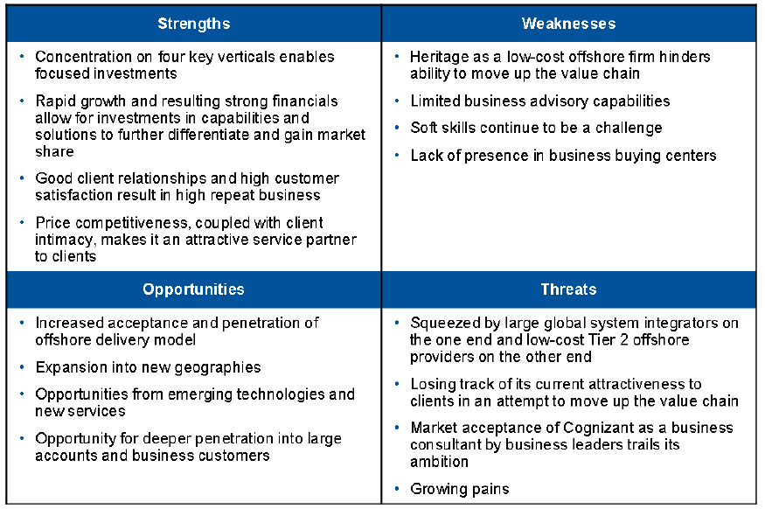
SWOT Analysis: Consulting & System Integration Services
Gartner Report

Slide 30
Executives Speak
“Server virtualization has helped our customers achieve up to 75 per cent reduction in power and cooling costs and 35 per cent reduction in hardware costs through cost amortization. Besides increasing the average utilization of the compute environment—even doubling it in many instances—virtualization has helped bring down lead times for server provisioning from months to hours, and deliver substantial reduction in management costs via automated operations.”
A N Rao, Cognizant’s Senior Vice-President of IT Infrastructure Services
“As the macro environment continues to be challenging in Europe, clients have become keener to move more work to a global delivery model. The economic climate is also the reason for a structural shift from discretionary projects earlier to more critical and larger annuity-based outsourcing deals from Europe now.”
Rajeev Mehta, Group Chief Executive for Industries and Markets on Europe market
“We continue to build out our capabilities in SMAC (social, mobile, analytics, and cloud) technologies. We continue to see strong evidence that SMAC is the next secular shift in computing and we are investing accordingly. We’ve had some great client wins across our SMAC practices. As enterprises around the world focus on digital transformation of their operations and SMAC becomes ever more prevalent in the industry, we are seeing that our early lead and thought leadership in this area gives us a distinctive competitive edge in the market.”
R. Chandrasekaran, Group Chief Executive for Technology and Operations
“In the use of hybrid cloud models,” he adds, “a well thought-out integration strategy, while defining the architecture for cloud-based systems, is critical in ensuring that disparate hybrid cloud components utilizing various cloud service models get along well.”
Mahesh Venkateswaran, Managing Director of Social, Mobile, Analytics and Cloud
Notes:
http://news.cognizant.com/anrao-fc-aug31-2013?year=2013
http://news.cognizant.com/rajmehta-hbl-aug16-2013?year=2013
http://news.cognizant.com/mahesh-cnme-aug5-2013?year=2013

Slide 31
Executives Speak
“As a highly customer-centric industry, banks and financial service providers need to make sure they are attacking fraud strategically and not disrupting their customers’ banking experience. The key to accurate and non-disruptive fraud detection is to implement emerging technology that allows banks to gain a holistic view of customers. This view of fraud detection uses data available from a variety of sources -- mobile data, along with social data from Facebook and Twitter -- and uses it to distinguish fraudulent activity from normal activity.”
Karthik Krishnamurthy, Vice-President of Enterprise Information Management on Big Data in Banking Services
“The strategy of acquiring for capability and not capacity is central to Cognizant's acquisition philosophy. The approach is to look at small “tuck-under” acquisitions that add capability in specific areas. Given the size of Cognizant today, the company’s sweet spot really is in the $20 million to $80 million range, maybe going up to $200 million.
Francisco D’Souza ,Cognizant CEO on acquiring strategy
“As we look to the rest of the year, budgets have been frozen as expected and we do expect discretionary spending to start from Q2 onwards. That’s the reason we’ve given good guidance of 5.4 percent for Q2 and have also reaffirmed our guidance of at least 17 percent for the full year. We’re happy with the investments we’ve made in our own capabilities. Cognizant sees demand coming from two different mandates. One is to help our customers run their businesses better. The second is to help them transform their businesses leveraging technology.”
R. Chandrasekaran on Cognizant’s Growth drivers
Notes:
http://news.cognizant.com/frank-ht-may10-2013?year=2013

Slide 32
Key Acquisitions
Date | Company | Space | Domain Specialists | Details
Dec 2012 | 6 C1 Group Companies | Application services and Consulting | 500 | Enhances enterprise application and high-end testing/consulting services to European clients
Nov 2012 | MediCall | Medical management solutions | 600 | Accreditation by URAC allows to offer specialized clinical services in the areas of group health and workers' compensation utilization management
Sep 2011 | Zaffera | Retail-Focused SAP Consulting | 100 | Enhances and expands the ability to provide industry-focused SAP consulting and software solutions to major retailers
July 26, 2011 | CoreLogic Global Services Private Limited (CoreLogic India) | Captive operations | - | Cognizant will acquire CoreLogic India. The purchase price will consist of a cash payment of approximately $50 million, plus adjustments. CoreLogic India, whose approximately 4,000 associates will become employees of Cognizant at closing, provides capabilities in software product development, analytical modeling, domain-centric back-office services, and technology support to CoreLogic and its customers
June 21. 2011 | India Unit Services Business of Oracle Financial Services Software Limited | Financial Services Software | _ | Credit Suisse is advising Oracle through its New York office for the transaction. Credit Suisse has approached only a handful of bidders for a potential deal. Wipro Ltd., HCL Technologies Ltd. and Larsen & Toubro Infotech Ltd., which were among those interested, are no longer in contention. Oracle has also scaled down its original expectation of around $400 million-$500 million for the services business.
17 June 2010 | Galileo Performance | Testing, Consulting | - | CTS acquired Galileo Performance, a Paris-based provider of IT testing consulting services. This acquisition will expand and complement its global testing practice and also enhance its footprint in France.
10 May 2010 | PIPC | Program Management Consulting | 200 | Program management services, methods and tools, including PMO (Project Management Office) core competency and PhD (Project Health Diagnostic) tool.
Notes:
http://globalbb.onesource.com/web/Reports/ReportMain.aspx?KeyID=42851006&Process=CP&Report=SIGDEVS

Slide 33




Strategic Allainces
SOA: Hardware & Software
Oracle 8i Data warehouse
End to End Solution: Infrastructure service
ERP: Maintenance, support & upgrade
Notes:
http://www.cognizant.com/partners

Slide 34








Technology Partners
Expertise
Technology Solution provider: IT Infrastructure
Business Analytics Software
Adobe solution, infrastructure
Business Infrastructure Software for SOA, ESB, BPM and Application Modernization
Extraction Transformation and Loading (ETL) ,Data ware house
XML
CRM Solutions
CRM Solutions
Notes:
http://www.cognizant.com/partners

Slide 35




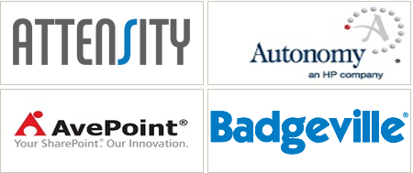
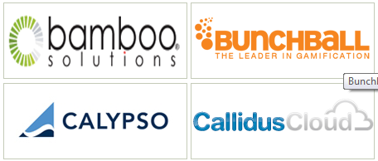
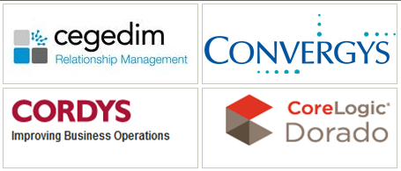






Technology Partners
Notes:
http://www.cognizant.com/partners

Slide 36
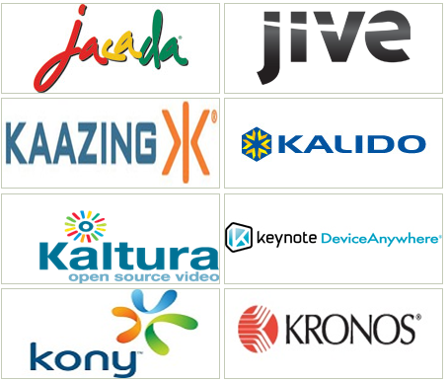
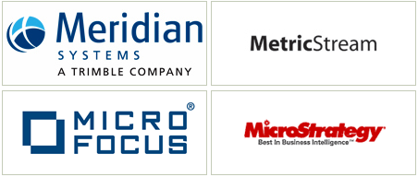


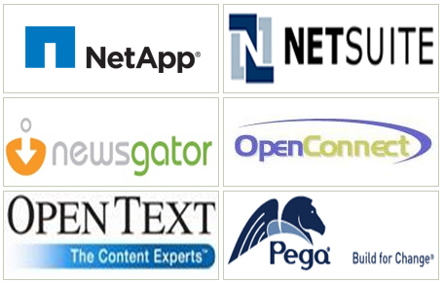


Technology Partners
Notes:
http://www.cognizant.com/partners

Slide 37
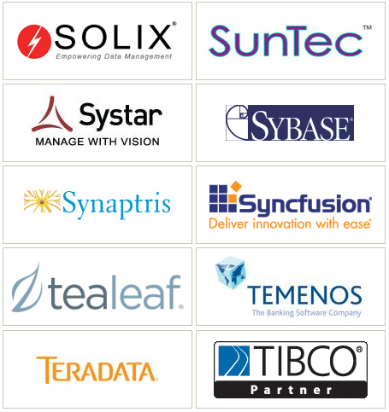
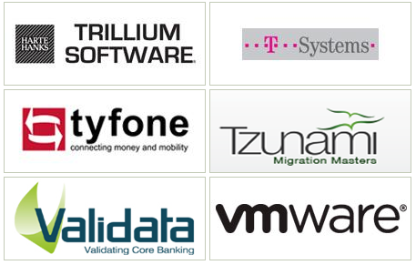



Technology Partners
Notes:
http://www.cognizant.com/partners

Slide 38
Analyst Comments
Named a leader in the North American workplace services outsourcing wave for 2013 by Forrester
Cognizant Recognized as a Leader in Life Science Drug Safety Services in IDC MarketScape.
Recognized as a Leader in Capital Markets BPO by Everest Group
Positioned in the "Leaders" Quadrant of Gartner’s 2012 Magic Quadrant for CRM Service Providers Worldwide
Gartner included Cognizant as a Leader in the Magic Quadrant for customer relationship management consulting and solution implementation services worldwide
The Everest Group recognized Cognizant as a leader in their matrix for health care payer application outsourcing
Gartner included Cognizant as a Challenger in the Magic Quadrant for SAP Implementation Service Providers, North America, 2012
Gartner included Cognizant as a Visionary player in the Magic Quadrant for Finance and Accounting BPO, May 2012
IDC reported that Cognizant is among the top 3 preferred IT services vendors for life sciences companies (April 2012)
Forrester: Cognizant creates mobility solutions in a variety of arenas but will be particularly well-suited where it already has a strong practice - especially in areas including CRM, analytics, and supply chain

Slide 39
Rank in Industry
Cognizant has jumped 46 places in the FORTUNE 500, which was released on May 7, 2013, and is based on revenue for the 2012 fiscal year.
Cognizant has topped the client satisfaction and relationship rankings in KPMG's Outsourcing 2012 study of service provider performance across Europe (Dec 2012)
Cognizant ranked among the Top 10 Happiest Companies in America at the “CareerBliss 50 Happiest Companies in America” Awards (Dec 2012)
Cognizant topped KPMG's Client Satisfaction and Recommendation Rankings in the Nordics (May 2012)
Cognizant jumped 86 places in 2011 in the FORTUNE 500 (May 2012)
Cognizant has moved to the 27th spot compared to 30 in 2010 in Gartner's Global ranking (May 2012)
Cognizant ranked at number 6 in Vault IT Consulting 25 for 2012 (April 2012)
2012 Readers’ Choice Awards, Consumer Goods Technology: Cognizant ranked in the top four in the Outsourcing category and came in at fifth place in the Consulting category
Notes:
http://news.cognizant.com/fortune500-may7-2013?year=2013

Slide 40
Key Investments
2009-10
2011-12
2013
CTS also announced a new testing platform to enable the company to deliver greater value in the area of testing, developed by Cognizant's Testing Practice, the platform will facilitate ideation, catalyze knowledge sharing and showcase testing innovations that help reduce testing effort, time and cost while improving quality.
Launched new service offering in Engineering & Manufacturing Solutions through its relationship with Invensys. Engineering & Manufacturing Solutions Practice has grown to nearly 1,000 associates in under two quarters.
CTS continues its investment in technology platforms like Cognizant 2.0 which has increasingly become a key differentiator for the company in new wins like it was in the case of Invensys
In August 2011, CTS acquired the India-based operations of CoreLogic Incorporated to enhance our offering in the residential mortgage processing space. CoreLogic India, with approximately 4,000 associates, provides software product development, analytical modeling, back-office and technology support services that are crucial to the U.S. mortgage and real estate markets.
In September 2011, CTS acquired Zaffera, LLC, a strategic SAP retail consulting and
software development firm based in Princeton, NJ. Zaffera helps top retail brands navigate the rapid changes in the retail sector brought about by new technology and demographic shifts.
In 2012, Cognizant is providing a comprehensive range of consulting and application services to enable Philips to rationalize and enhance its IT services model. The result will be a better approach to IT delivery via an output-based platform that is nimble and allows for a variable cost structure
CTS Service delivery enabled by Cognizant 2.0, a proprietary Web 2.0-based platform that enables knowledge sharing and collaboration across global teams to benefit every customer engagement.
CTS has invested a large amount in Cloud services . Has classified all cloud based solutions and platforms under “Business Cloud Solutions” - a suite of ready-to-deploy, on-demand business and IT solutions.
Significant investment in social, mobile, analytics and cloud (SMAC) paying off. Expects revenue of ~ $500 mn in 2013
Investments in new capabilities such as Enterprise Analytics Practice (EAP), and Engineering and Manufacturing Solutions Practice (EMSP)
Notes:
http://www.cognizant.com/aboutus/SiteDocuments/Cognizant_Annual_Report_2011.pdf

Slide 41
Recent Milestones
Q3 2013
Q4 2013
Q1 2014
Cognizant Positioned in the "Leaders" Quadrant of Leading Industry Analyst Firm's 2012 Magic Quadrant for CRM Service Providers Worldwide, by Gartner Inc. (released on September 20, 2012) .
Cognizant has topped the client satisfaction and relationship rankings in KPMG's Outsourcing 2012 study of service provider performance across Europe. The company topped the rankings in general satisfaction and relationship management—both strategic and operational—with scores significantly higher than the industry average.
Cognizant’s Healthcare Business Process Services (BPS) operations have been accredited by Utilization Review Accreditation Commission (URAC),as a leader in promoting healthcare quality.
In its very first showing at the CareerBliss 50 Happiest Companies in America Awards, Cognizant ranked among the Top 10 Happiest Companies in America.
Leader in Capital Markets BPO by Everest Group .
Cognizant Recognized as Informatica 2012 Outsourcing Partner of the Year .
Cognizant Recognized as a Leader in Life Science Drug Safety Services in IDC MarketScape .
Cognizant replaced the Infosys as the number-two player among offshore-centric information technology services companies at the end of the January-March quarter. Cognizant beat Infosys in terms of revenues on a full year basis, and in most of the operating parameters also.
"Leader" in "The Forrester Wave: North American Workplace Services, Q2 2013," (in North America) a report published by Forrester Research, Inc.
Cognizant jumps 46 places in 2012 in the FORTUNE 500 .
Cognizant Honored with the Growth Champion Award (IT) at the NDTV Profit Business Leadership Awards 2012 .

Slide 42
Key Executives
Name | Position
Sukumar Rajagopal | Senior Vice President & Head of Innovation at Cognizant Technology Solutions
Ramakrishnan Chandrasekaran | Group Chief Executive – Technology and Operations
Peter Grambs | VP and Practice Head, CRM
Sumithra Gomatam | SVP & Global Head, Testing Practice
Robert Boles | SVP, IT Infrastructure Services practice
Ashish Sonkusare | Director and SAP Practice Head for Consumer Goods
Kaushik Bhaumik | Vice President-Business Technology Consulting
Veera Narayanaswamy | VP/Practice Head of Data Warehousing & Business Intelligence

Slide 43


Key High Tech Executive Profiles
Sumithra Gomatam, SVP & Global Head, Testing Practice
Career Path:
Senior Vice President & Chief Information Officer at Cognizant Technology Solutions(May 2010 to present)
Senior Vice President & Head of Innovation at Cognizant Technology Solutions
Past Senior Vice President & Chief Knowledge Officer at Cognizant Technology Solutions
Vice President - Manufacturing & Logistics at Cognizant Technology Solutions
Director - Eastern Region - T/IME/R&H/M&L at Cognizant Technology Solutions
Account/Program Manager at a Key Media Industry Client at Cognizant Technology Solutions
Senior Systems Analyst at TATA Consultancy Services
Education:
Birla Institute of Technology and Science
University of Pennsylvania - The Wharton School
Ramakrishnan Chandrasekaran, Group Chief Executive – Technology and Operations
Chandra is responsible for growing capacity, expanding global delivery network, achieving ever greater excellence in delivery management through process and quality initiatives, and proactively nurturing key alliances and business partnerships. Chandra’s focus is on ensuring that we maintain our track record of exceptional delivery and our disciplined approach to bringing new services to the market.
Chandra has been with Cognizant since its inception in 1994 and has played a variety of roles in developing Cognizant’s value proposition and executing our strategy. Prior to his current role, Chandra served as President & Managing Director of Global Delivery where he was instrumental in implementing a vertical structure in our core business and in introducing specialized service offerings. Chandra actively represents Cognizant in a number of industry forums, including NASSCOM and the Confederation of Indian Industries (CII).
Chandra obtained his Bachelor's degree in mechanical engineering from the National Institute of Technology (formerly the Regional Engineering College) in Trichy and his MBA from the Indian Institute of Management, Bangalore. He is a 2008 recipient of the Distinguished Alumni Award from the National Institute of Technology, Trichy.

Slide 44
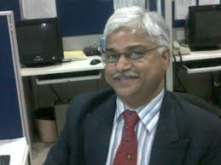

Key High Tech Executive Profiles
Veera Narayanaswamy , VP/Practice Head of Data Warehousing & Business Intelligence
Job Responsibility:
Globally heading the Data Warehousing, Business Intelligence and Performance Management [DWBI&PM] Practice, Enterprise Analytics Practice [EAP] and Oracle Solutions Practice [OSP] at Cognizant
Education:
Stanford University Graduate School of Business
Management Degree, Organizational Leadership and Strategic Innovation
2005 – 2005
Peter Grambs , VP and Practice Head, CRM
Job Responsibility:
Global head of the Customer Solutions Practice (CSP) at Cognizant. Full P&L responsibility for the 6,000 person practice. CSP, with major operations in North American, Europe, India and AsiaPac, is responsible for all CRM, BPM, MDM and other major customer facing functions. This globally recognized practice provides full life-cycle support including consulting, program and system design, implementation, and support across a wide range of global 2000 clients.
Education:
University of Pennsylvania - The Wharton School
MBA, Finance
1985 – 1987
Swarthmore College
BA, Pol. Sci & History
1975 – 1979
Parkdale Sr. High
1972 – 1975

Slide 45
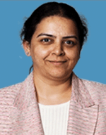
Key High Tech Executive Profiles
Sumithra Gomatam, SVP & Global Head, Testing Practice
Career Path:
Senior vice president
Cognizant Technology Solutions
January 1995 – Present (18 years 9 months)
Consultant
Tata consultancy services
1990 – 1995 (5 years)
Education:
University of Pennsylvania - The Wharton School
MBA, Finance
1985 – 1987
Swarthmore College
BA, Pol. Science & History
1975 – 1979
Parkdale Sr. High
1972 – 1975

Slide 46

Key Executive Profiles
Paul Nowacki, Global Leader in Cognizant’s Finance & Accounting Center of Excellence
Career Path:
In this role, he oversees all F&A service delivery for existing clients and solution design for prospects, worldwide. Paul also serves as a thought leader in F&A and helps identify market trends and shape new Cognizant offerings. By combining industry experience in IT and finance leadership roles with experience as a transformation consultant, Paul takes a holistic look at finance and accounting organizations, helping clients to optimize process, systems and organizational design.
Paul.Nowacki@cognizant.com
Imran Masood, Manufacturing, Logistics and Technology BPO Practice Leader
Career Path:
He works closely with business leaders to help create innovative solutions leveraging Cognizant’s core strengths of technology, industry best practices and process reengineering.
Imran has over 12 years of professional experience in the areas of business process reengineering, operations delivery and relationship management and has also worked with many Fortune 500 companies, helping them in the areas of shared services setup, offshoring strategy and process innovation with a special focus on multi-location technology leveraged global environments.
Prior to Cognizant, he worked at General Electric, PepsiCo and Siemens.
Education:
He holds degrees in management and electrical engineering and is a certified Six Sigma black belt and a project management professional.
Imran.Masood@cognizant.com.
*Refer to slide 16

Slide 47
Send your feedback / suggestions to the analyst team:
Aditi.Royghatak@tcs.com
D.Basak@tcs.com
Sonnet.Das@tcs.com
Aniket.Agao@tcs.com

